Slide 1
TOURISM WEBSITE
Group-8
Team Member and Roll No.
Nandini - 2210990597
Neeshu - 2210990603
Muskan - 2210990588
Submitted to - Ms. Meena Rani

Slide 2
INDEX
Introduction
Objective
Features
Methodology, Approach & Techniques
Flow Chart
Result
Source Code (screenshots)
Conclusion
Reference

Slide 3

INTRODUCTION
"Plan, Book, and Share Your Travel Experiences"
"Discover, Explore, and Experience the World“
"Your gateway to unforgettable adventures. Find your perfect getaway, whether you're looking for a relaxing beach vacation, an urban escape, or an outdoor adventure. Let us help you plan your dream journey today!"

Slide 4
INTRODUCTION
Welcome to our travel booking website, your one-stop destination for planning and booking your next adventure. We're here to make your travel aspirations a reality.
Our user-friendly platform offers a seamless experience,
allowing you to :-
* Search,
* Compare Prices
* Book Hotels
Our real-time availability ensures that you have access to the latest prices, deals, and promotions, making it easy to find the best value for your money.

Slide 5
OBJECTIVE
Convenience
Time-saving
Access to Wide Range of Options:
Cost-effectiveness
Real-time Availability
Accessibility
User Reviews and Recommendations

Slide 6
METHODOLOGY
HTML: CREATE UI
CSS: STYLE UI
JavaScript: IMPLEMENT UI
JS Libraries & Framework: INTERACTIVE UI

Slide 7
HOMEPAGE FLOW
SECTIONS
Home
Contact
Package
Rating
Review

Slide 8
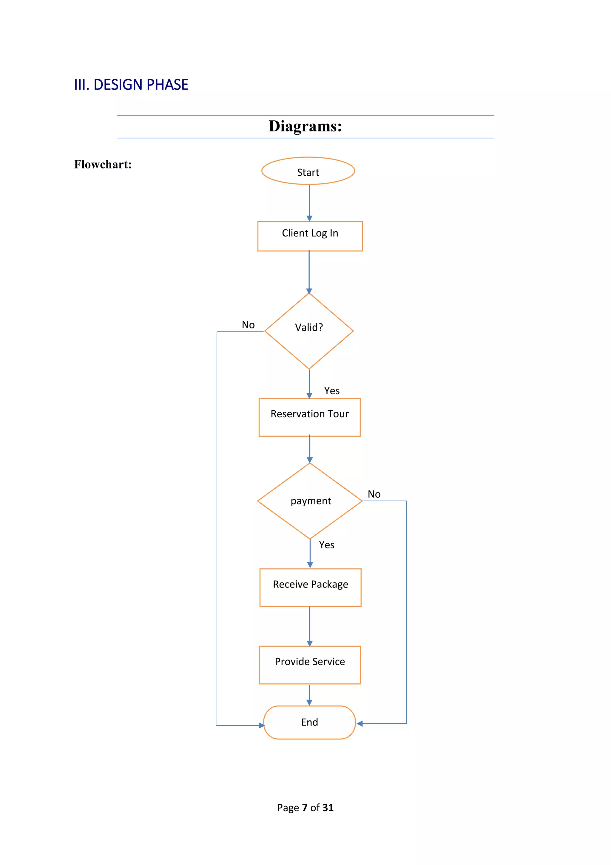
FLOWCHART (EXPLORING PACKAGE)

Slide 9
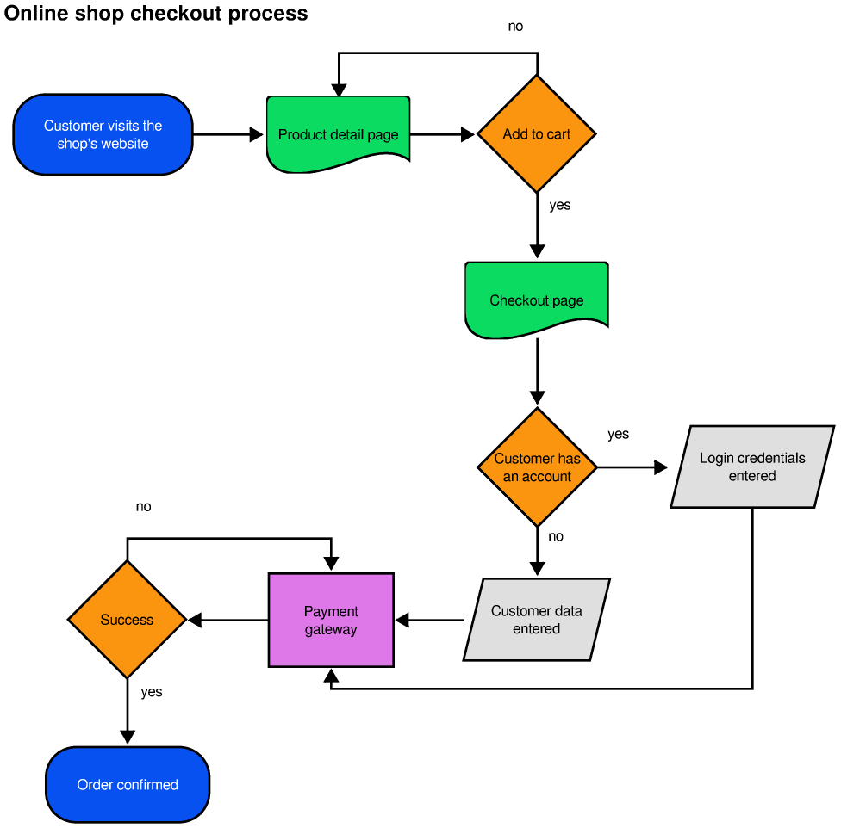
FLOWCHART (ADD TO CART)

Slide 10
FEATURES
Package filtering: Explore packages according to you city nd budget.
Add to Cart: Save your favorite options and book later
Booking On Spot: On the spot booking and confirmation of tickets with cancellation option.
User Engagement: Rate your experiences and leave comments for other travelers.

Slide 11
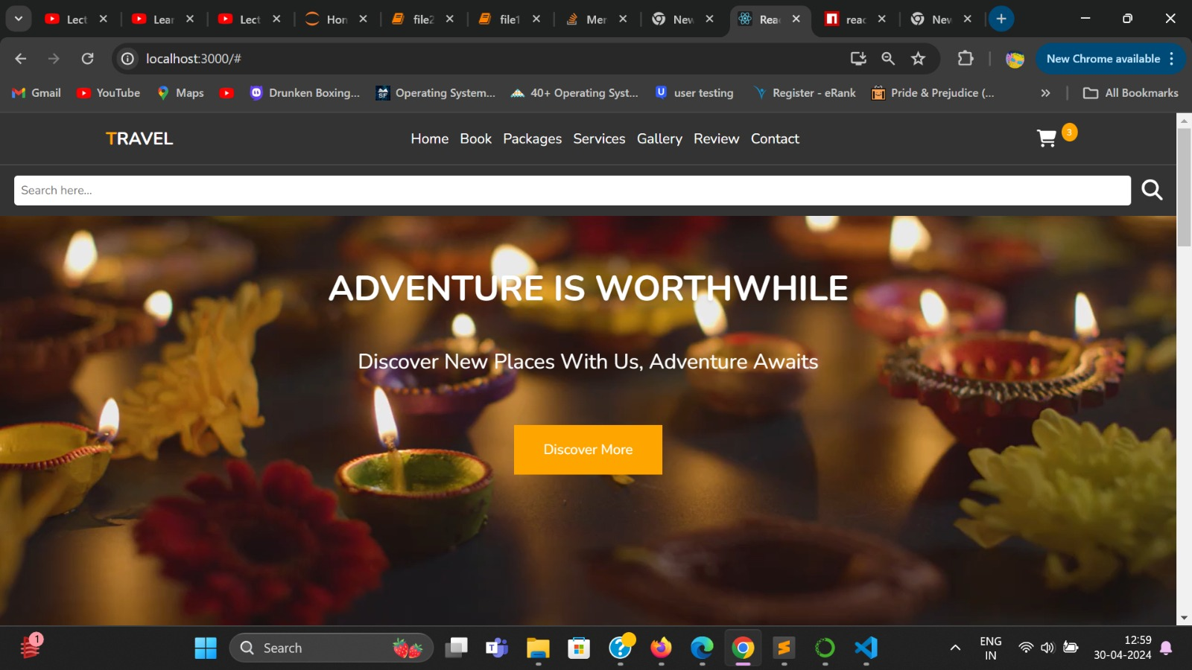
RESUTS (SCREENSHOTS)

Slide 12
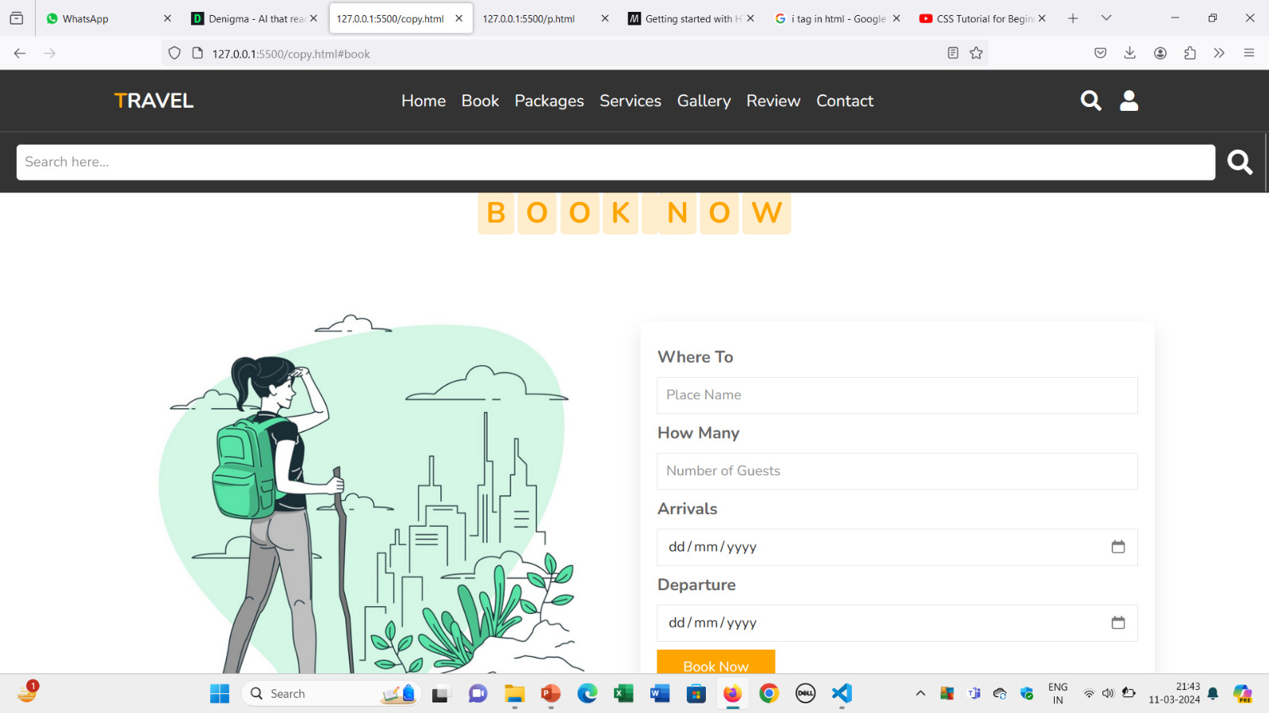
RESULT

Slide 13
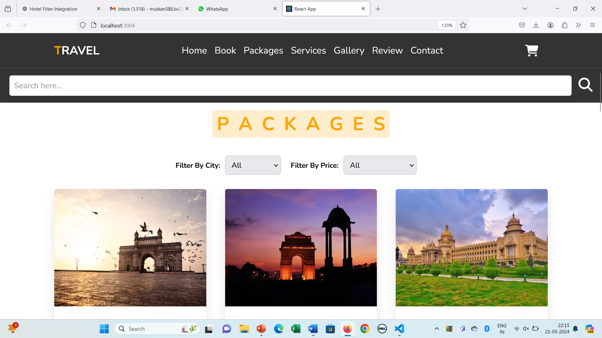
RESULT

Slide 14
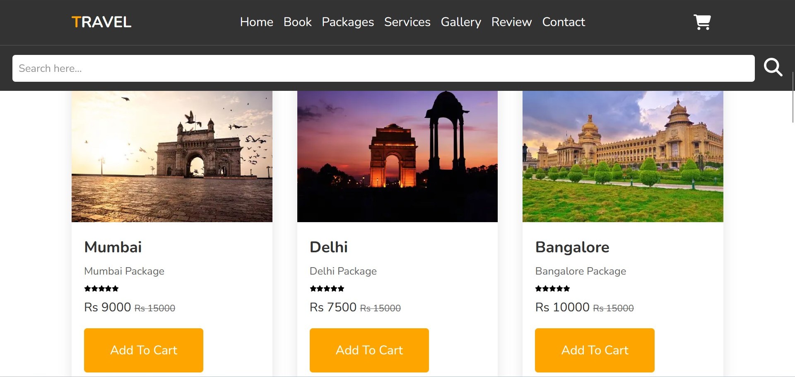
RESULT

Slide 15
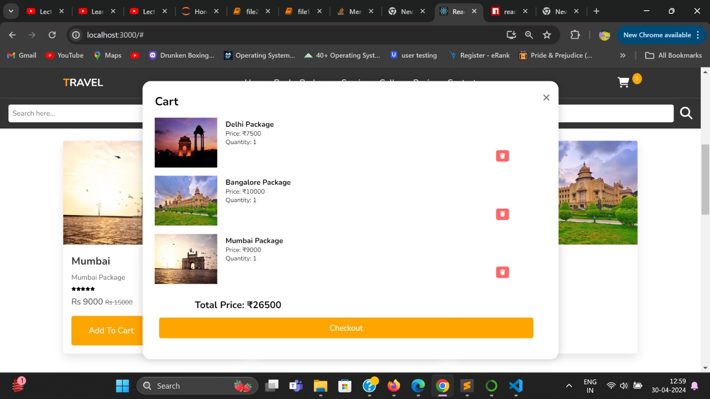
RESULT

Slide 16
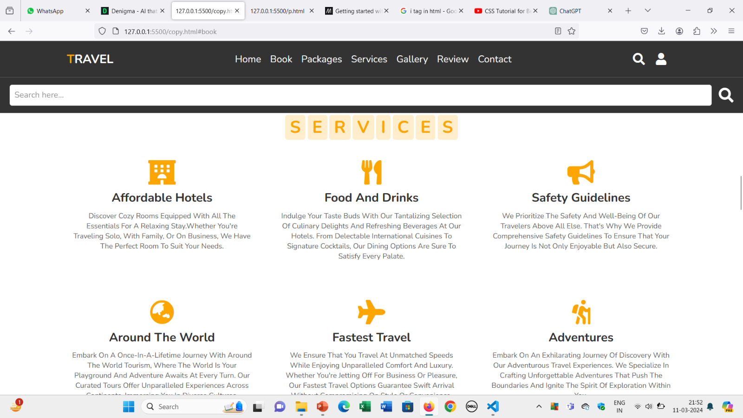
RESULT

Slide 17
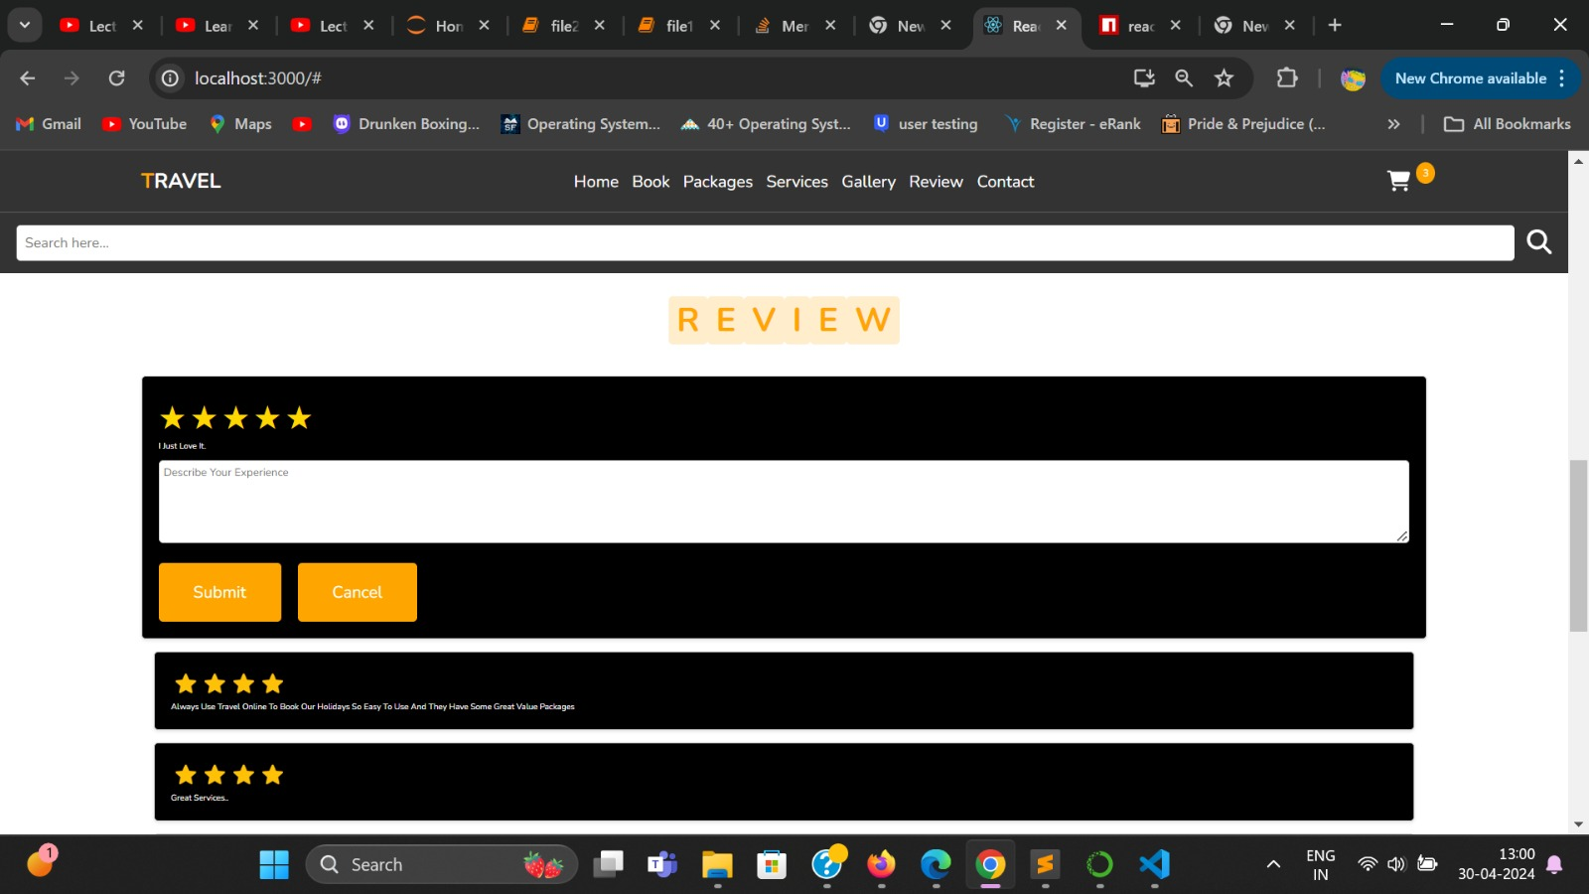
RESULT

Slide 18
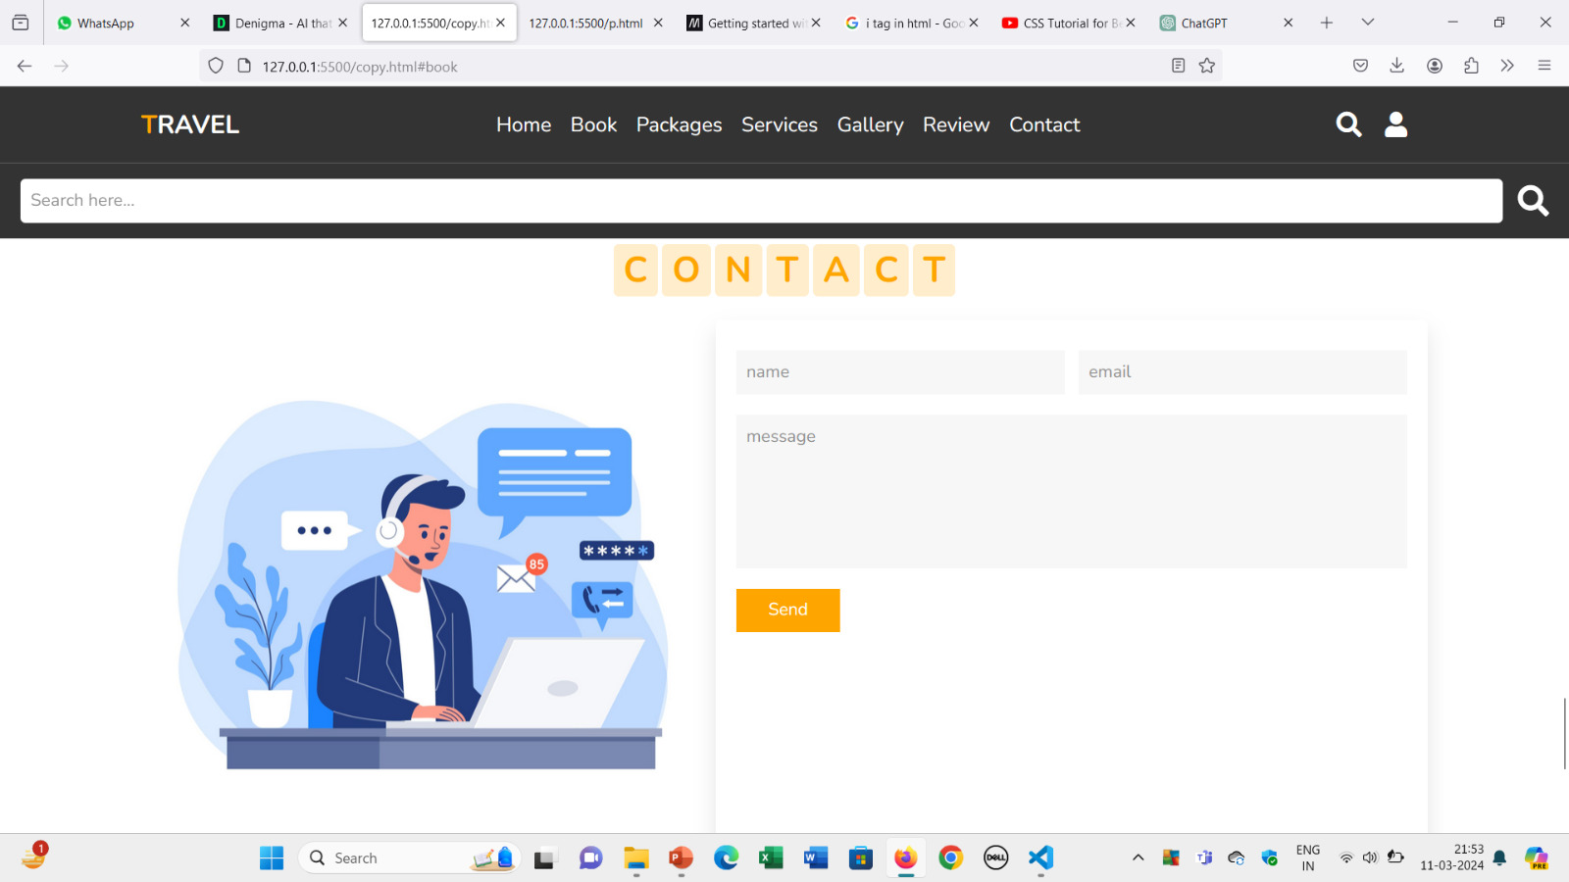
RESULT

Slide 19
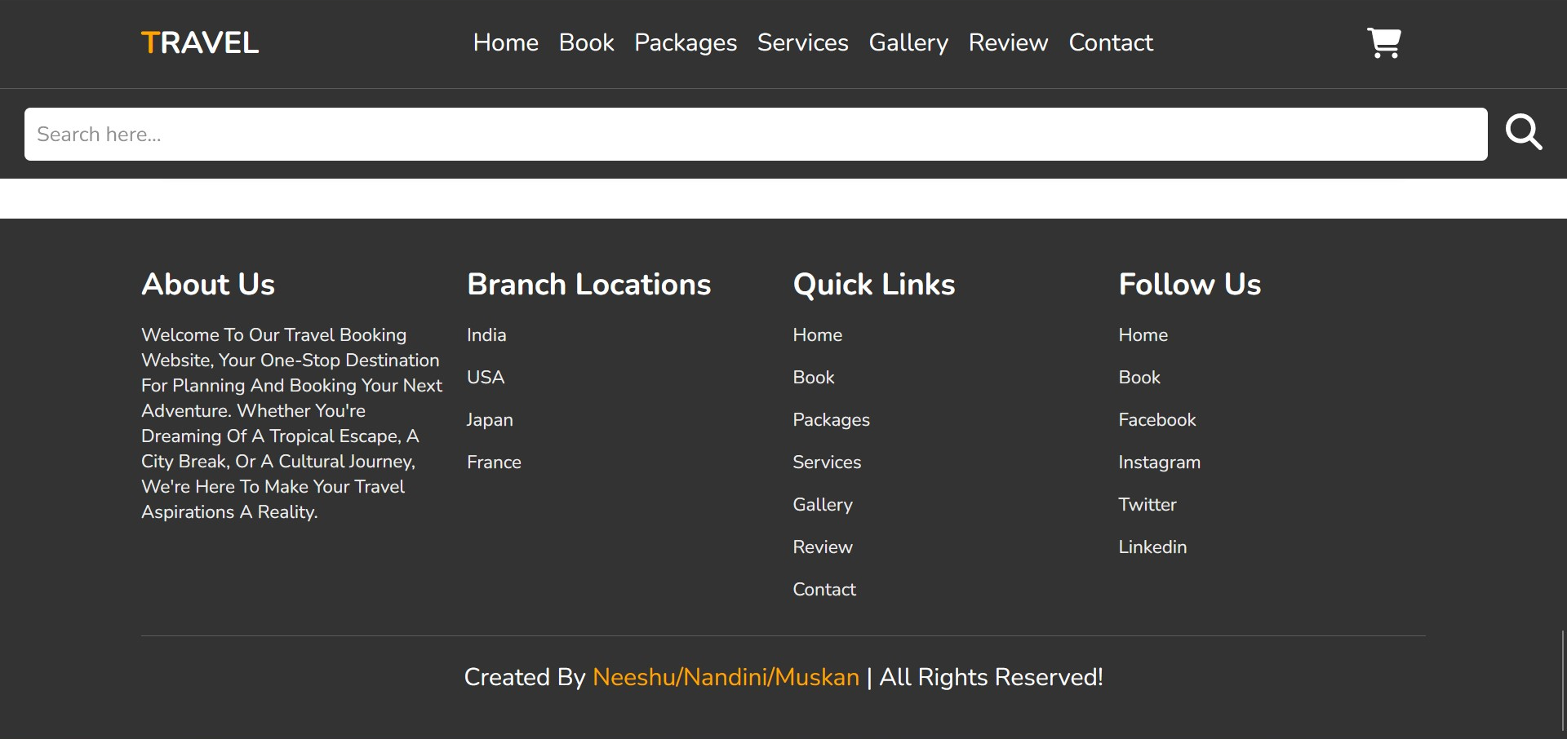
RESULT

Slide 20
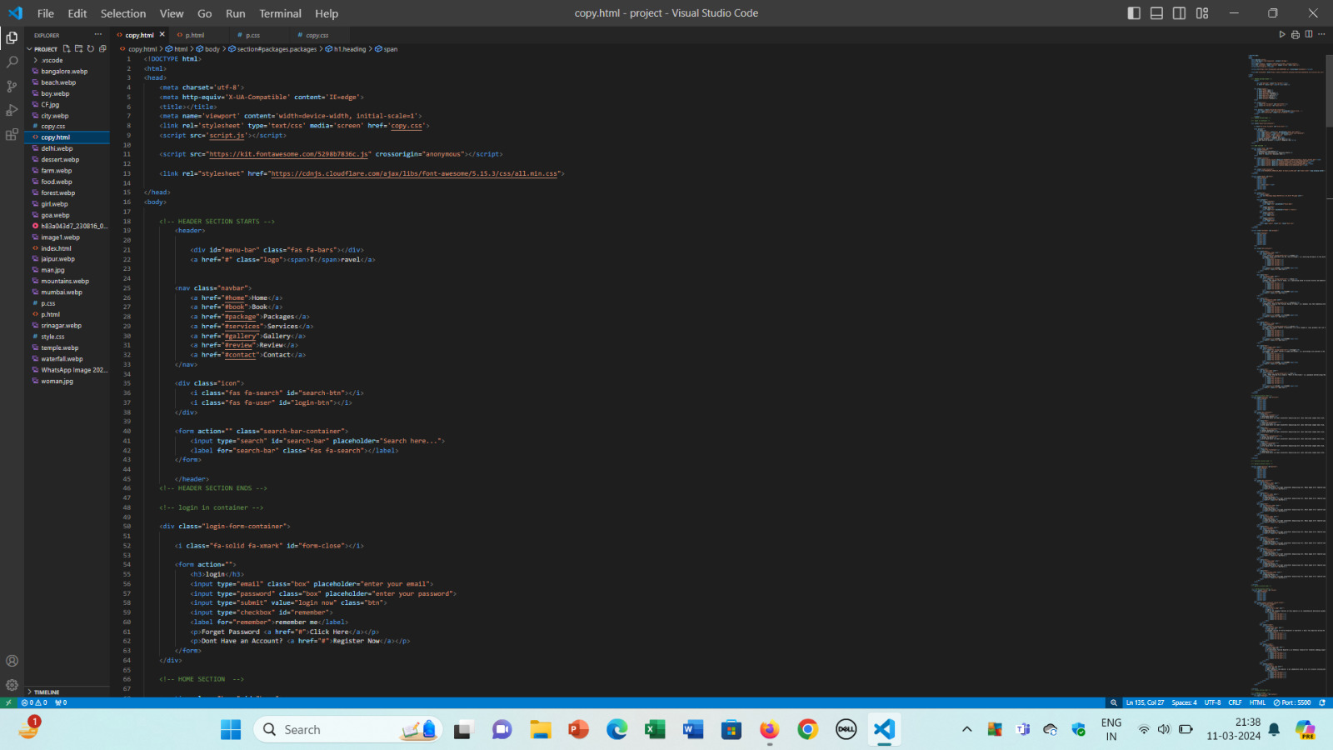
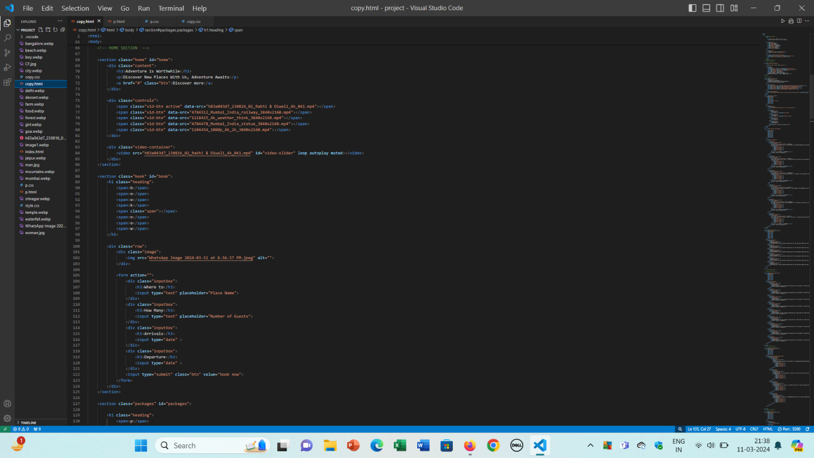
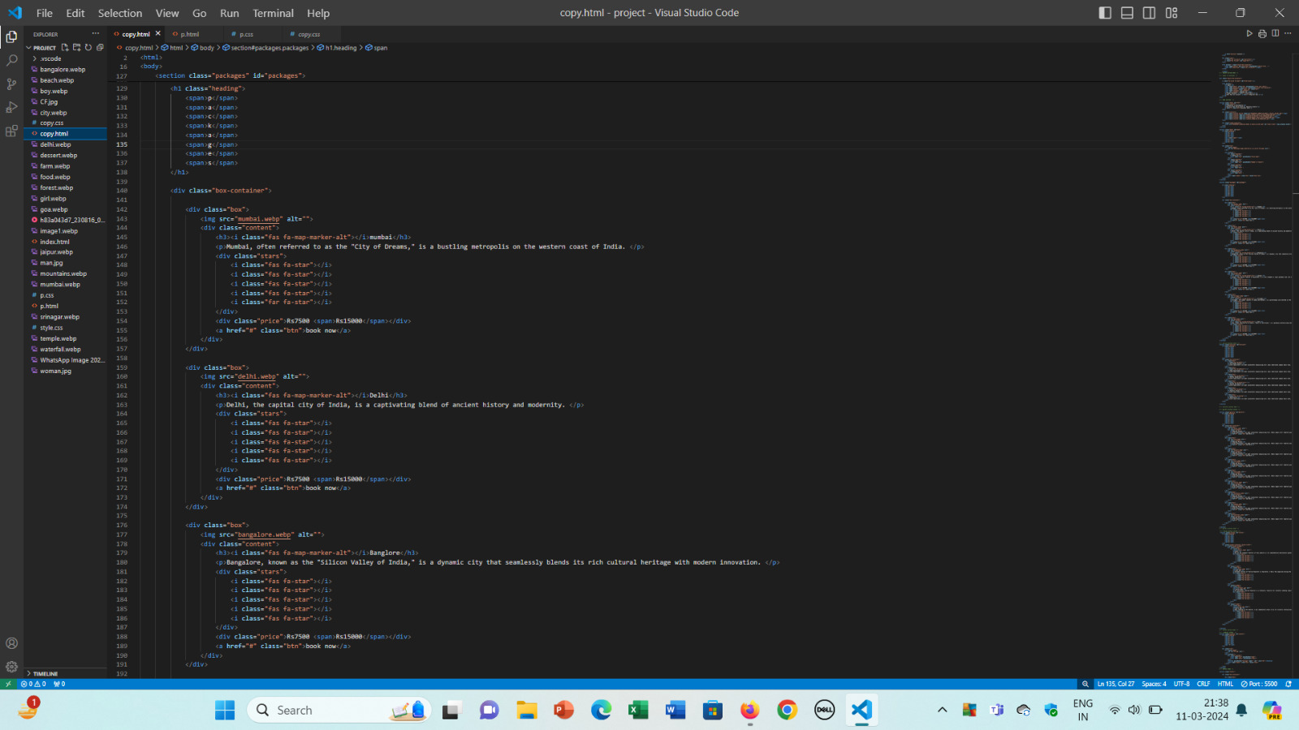
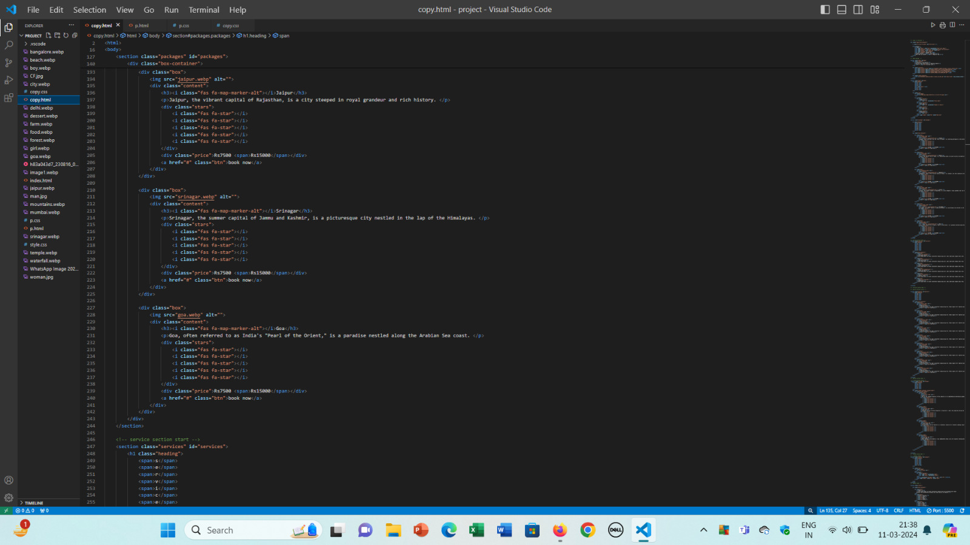
SOURCE CODE

Slide 21
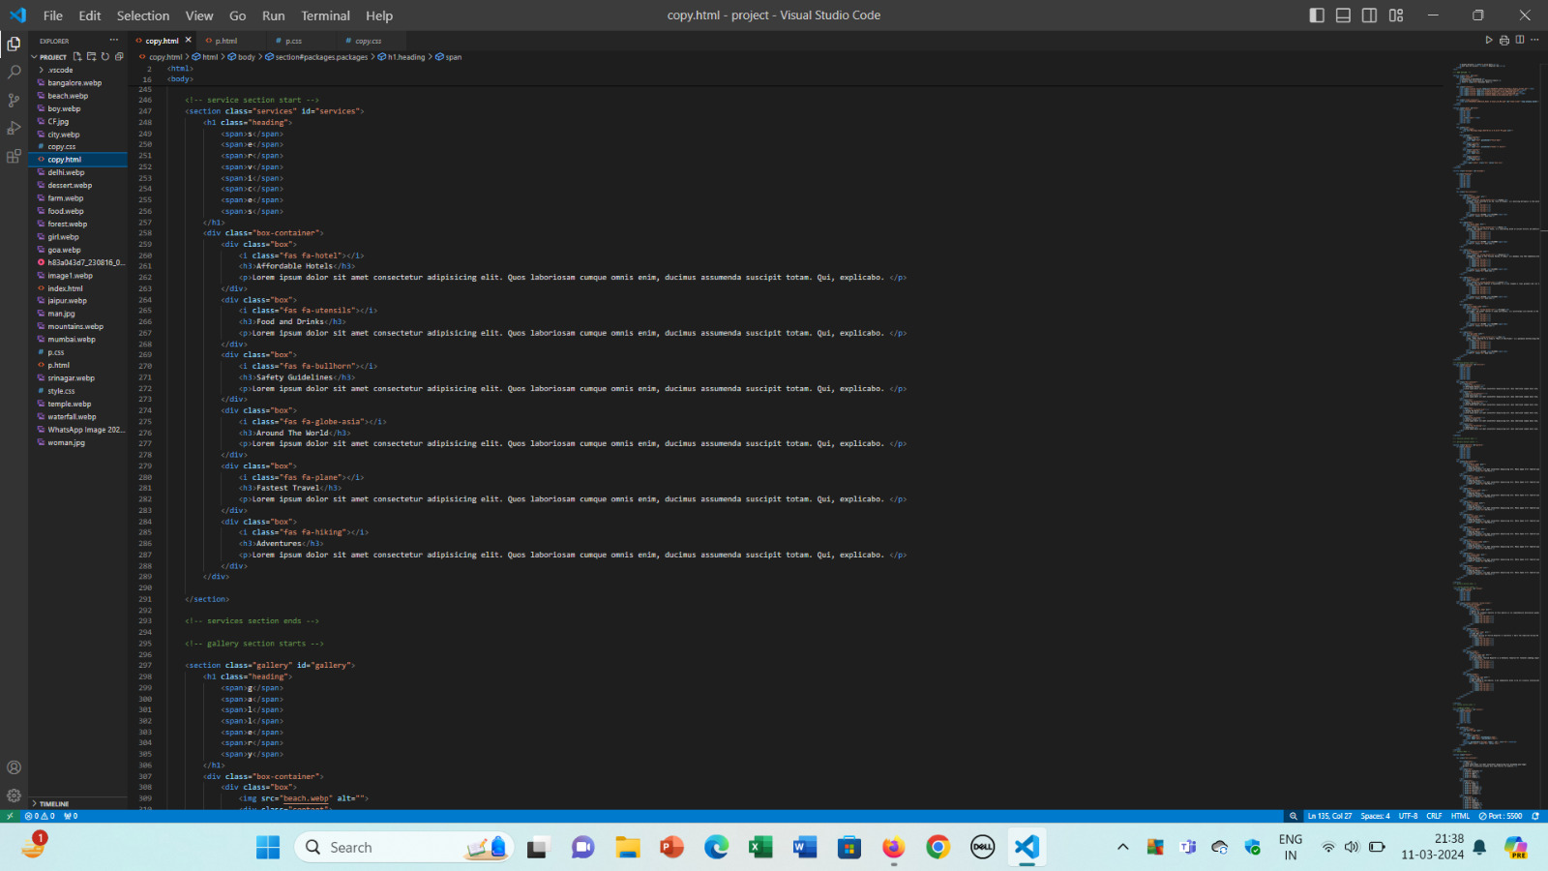
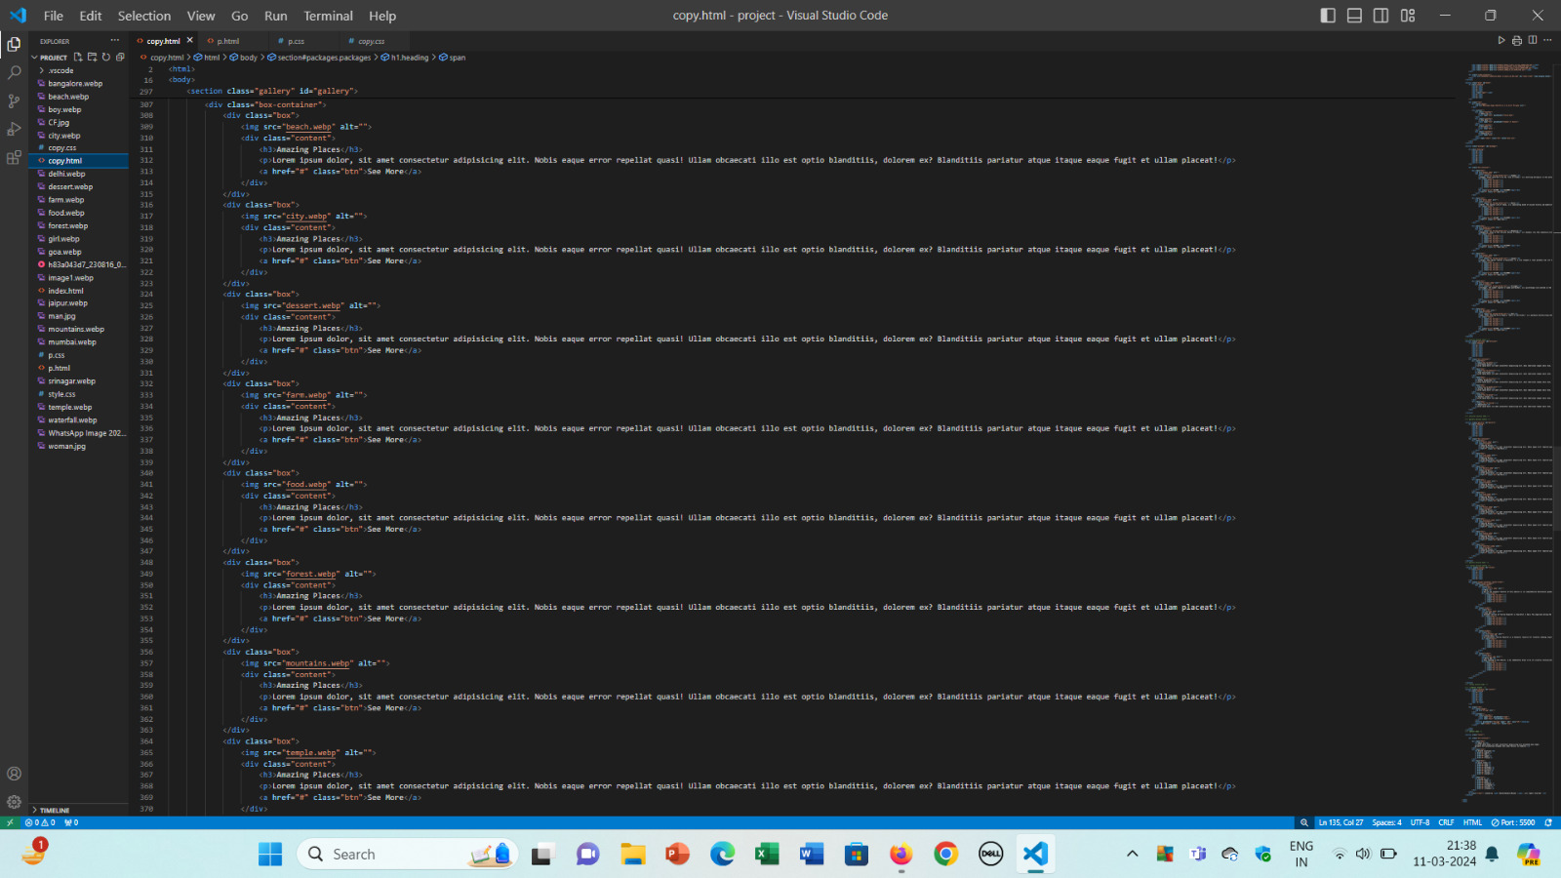
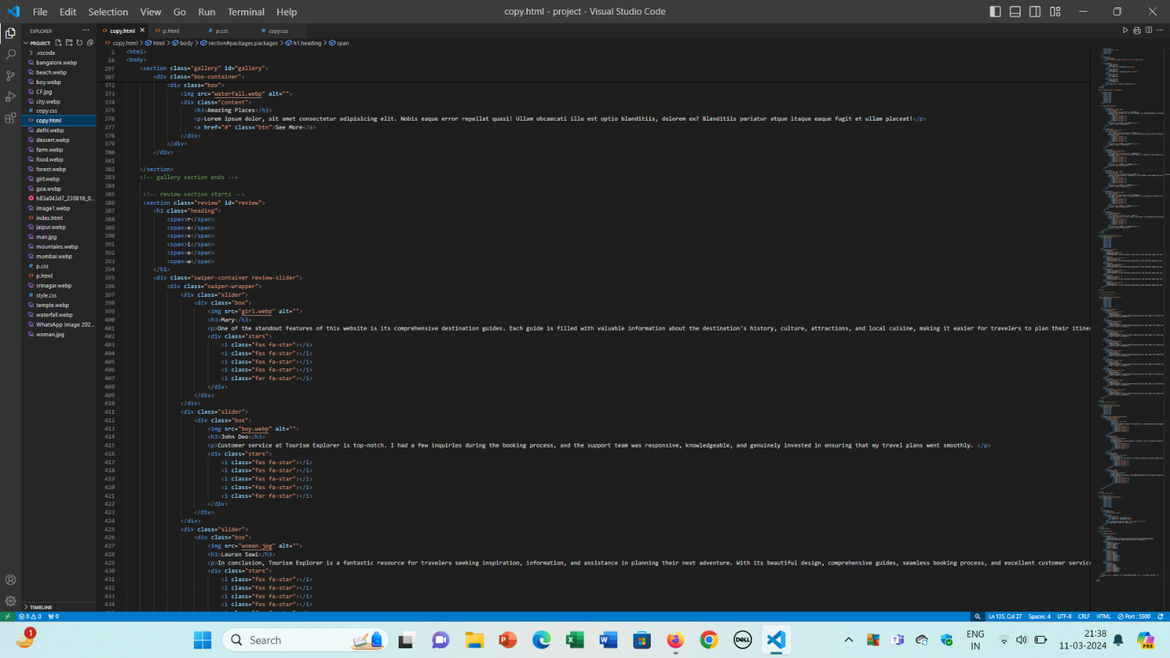
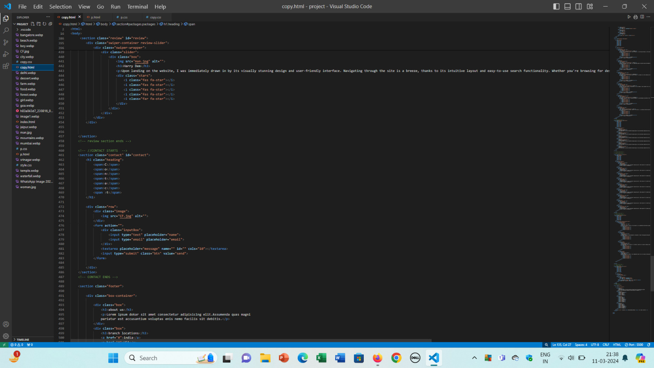
SOURCE CODE

Slide 22
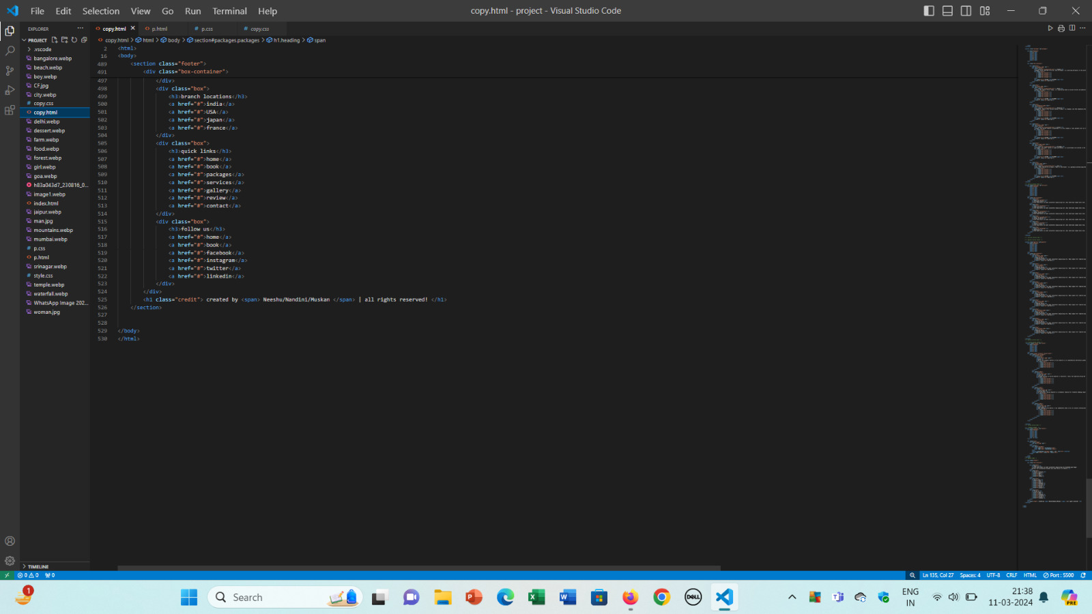
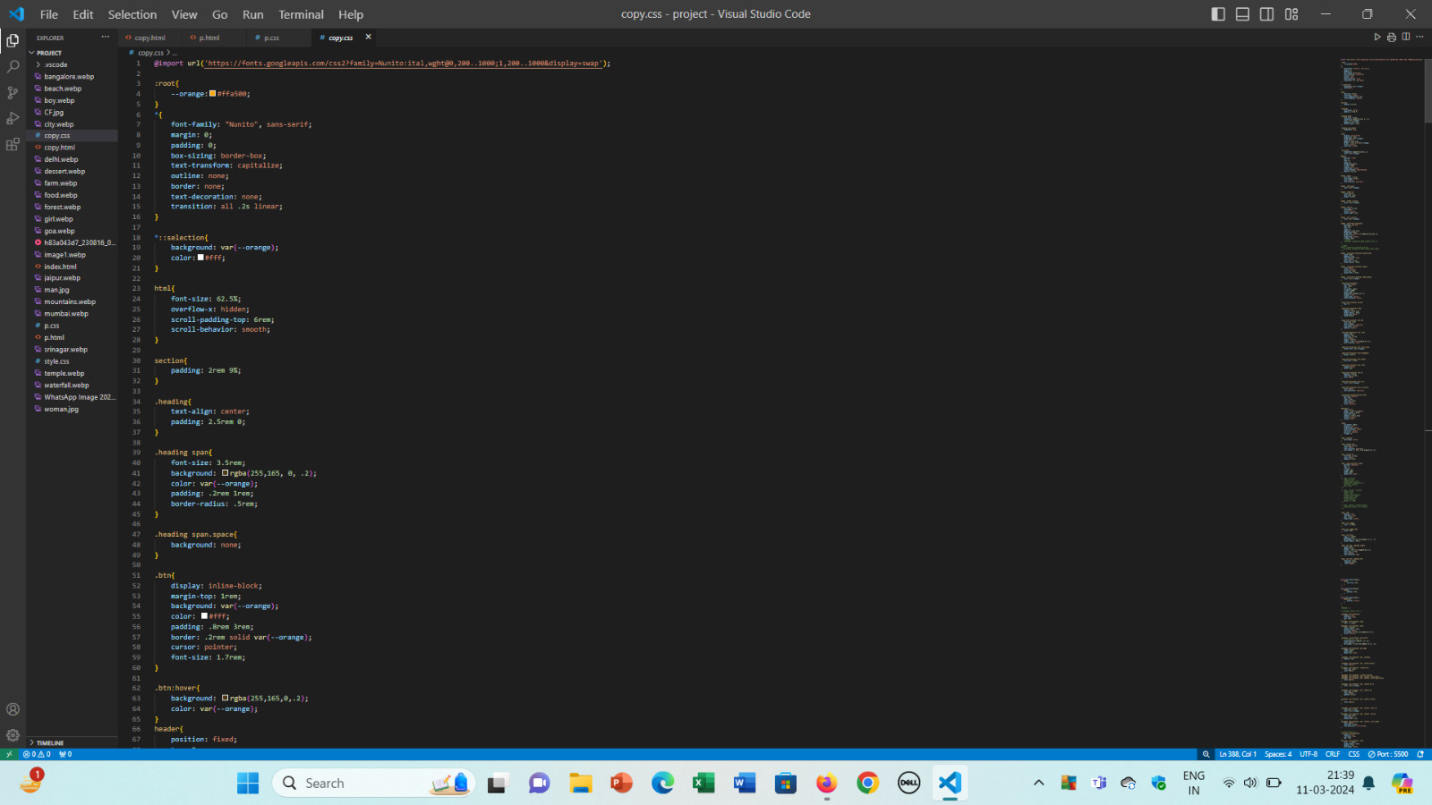
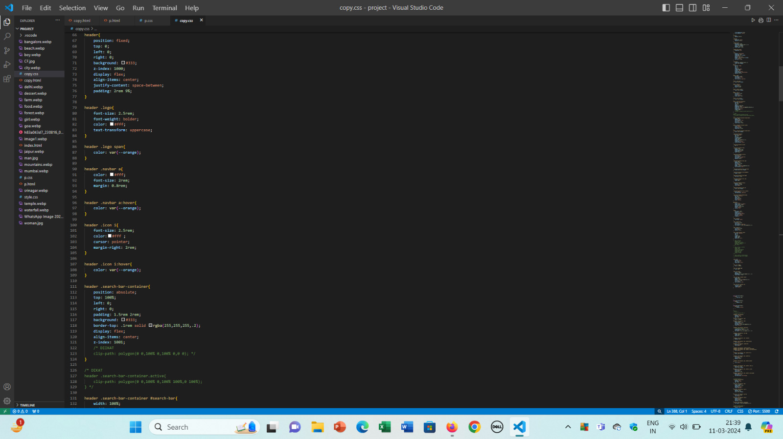
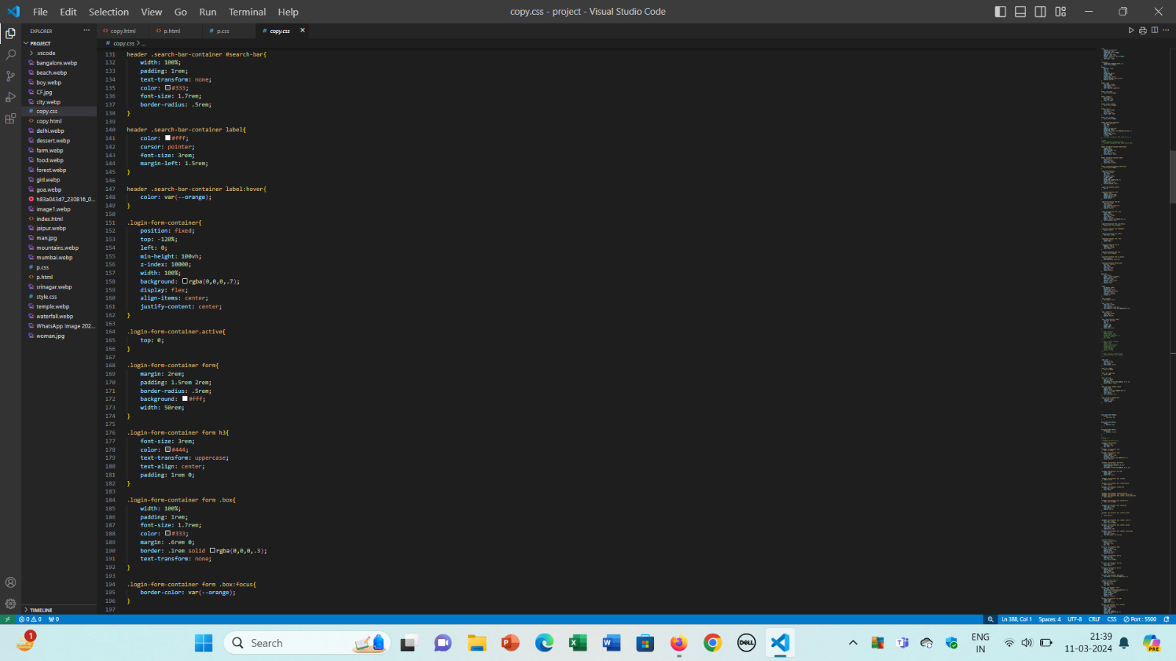
SOURCE CODE

Slide 23
CONCLUSION
Here is a conclusion for travel booking website:
Comprehensive Travel Solutions
User-Centric Experience
Interactive and Engaging
Personalization and Recommendations
Robust Technology Stack
Security and Reliability
Continuous Improvement

Slide 24
REFERENCE
[1] https://stackoverflow.com
[2] https://www.incredibleindia.org
[3] https://www.makemytrip.com

Slide 25
THE END!!

